Slide 1

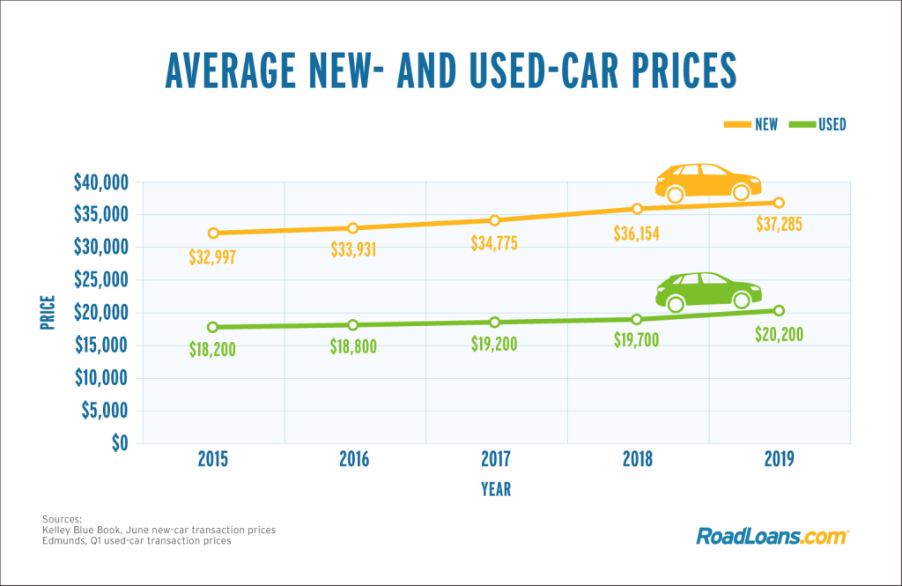
Car-Price-Prediction Project
Submitted by:
SK SHAHBAZ ALI

Slide 2
Exploratory Data Analysis

Slide 3
Steps
Creating my own dataset using web scraping
Importing the libraries needed for my project
Loading the dataset/Creating my dataframe
Checking the head of the dataset(first five rows)
Checking the shape of the dataset
Checking the datatypes
Checking for null values if any
These data analysis steps help us to get an overview of our dataset and also help us in our preprocessing of our data.

Slide 4
Preprocessing of the data

Slide 5
Steps and Description
I have checked for null values and there are some null values present,I have removed it using SimpleImputer method.
I have label encoded the object type columns in the dataset.
I have checked the correlation between dependant and independent variables using heatmap. I have seen most of the independent variables are correlated with each other and the target variable is positively correlated with a very few independent variables.
I have done some visualization using histogram.
I have checked outliers using boxplots ,but no outliers are present.
I also have checked for skewness in my data, but the skewness present is very negligible, so I don’t consider it.
I have splitted the dependant and independent variables into x and y.
I have scaled the data using StandardScaler method and made my data ready for model building.

Slide 6
Observation
From the correlation matrix (heatmap), I have seen most of the independent variables are correlated with each other and the target variable is positively correlated with a very few independent variables.

Slide 7
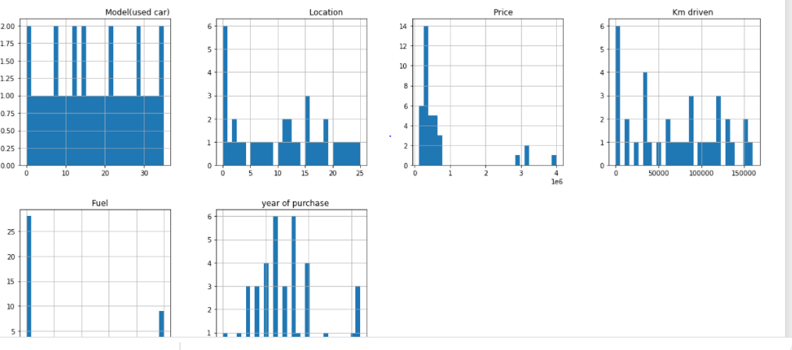
Some more preprocessing steps
Some visualization is done using histogram,boxplots where we can see how our data look like. I have attached some of the screenshots.

Slide 8
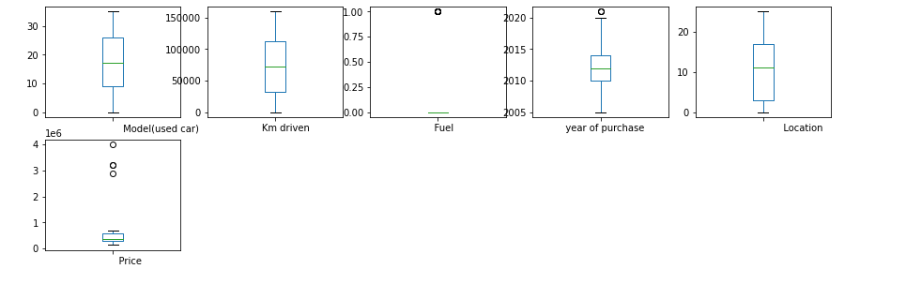
Now, I will see if any outliers are present in the data using boxplots. If there are outliers, I will use zscore method to remove it.By removing outliers ,we can clean our data.
Outliers are not present which can be seen from the plots.

Slide 9
Model building

Slide 10
Explanation
For model building, I have used 5 Regressor models(DecisionTreeRegressor(),KNeighborsRegressor(),AdaBoostRegressor(),LinearRegression(),GradientBoostingRegressor()),out of which AdaBoostRegressor model is the best model for my dataset.
For better accuracy of the model, I have used hyperparameter tuning (RandomizedSearchCV) and I have achieved 99% accuracy.

